Slide 1
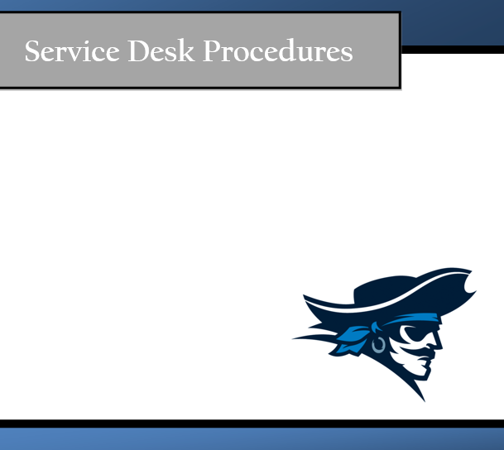

By Chase, Evelyn, Prisca, Jacob, & Brendan

Slide 2
Mission Statement
The mission of the Iowa Western Community College (IWCC) Help Desk is to assist in upping our internal and external user communities by enabling our users through making Information Technology resources readily available and accessible. We achieve this by providing assistance with electronic devices such as but not limited to; Smartphones, Tablet PCs, Apple iOS, and Netbooks in a single point of contact for customer-focused, quality services and support.

Slide 3
Help Desk Goals
Provide a timely and accurate statues update
Inform customer on request status and progress
Deliver high quality service
Monitor calls
Produce measurements and metrics
Ensuring users satisfaction

Slide 4
Service Level Agreement (SLA)
Availability- Will be open on Monday through Friday 9am-5pm. Will be close on holidays.
Tickets- Reassigning ticket to a new agent if it’s past over due.
Contacts- Will contact customers through e-mail, phone calls, and voice messages.
Reliability- Won’t be open on school breaks and holidays.
Performance- Will not keep customers waiting anymore then 2 minutes.
Security- Strong passwords will be used to access services.
Charging- Free for IWCC students.

Slide 5
Email and Internet Usage Policy
Email and internet extensions are assigned to an employee’s computer for the sole purpose of conducting company business. Some assignments and responsibilities at the help desk require access to the internet and email. Only technicians that are appropriately authorized, for company purposes, may use the internet to access and download any needed, additional software.
Email is also to be used for company/help desk business only. You are not to conduct any personal business using company computers or email. Non-business related emails waste company and employee time and attention. Any email content that discriminates any protected classification including age, race, color, religion, sec, national origin, disability, genetic information, sexual preference and even weight is prohibited.
Keep in mind that the company owns any communication that is sent via email or otherwise stored on company equipment, such as computers, flash drives, or external hard drives. Management and other authorized staff have the right to access your email or material on your computer at any time. Please do not consider your electronic communication, storage, connection, or access to be private if it is created or stored on work systems and servers.
Internet use on company time using devices that are connected to the company network is authorized to conduct company business only. Internet use also creates the possibility of contamination in our system via viruses, malware, and spyware. For this reason, and to assure the use of work time appropriately for work, we ask technicians to limit internet use.

Slide 6
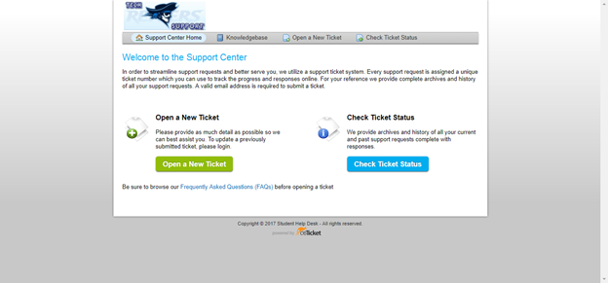
osTicket
osTicket is the ticket request system used for customers to request for services from the help desk. On the osTicket website, a technician can manage inquiries, messages, incoming tickets, the FAQ, and much more.

Slide 7
osTicket Content
Accessing the osTicket site
Opening a new ticket
Ticket Management
Tickets Front Page
Ticket Thread
Responding, Resolving, Closing
Using the FAQ
Setting Up New Users

Slide 8
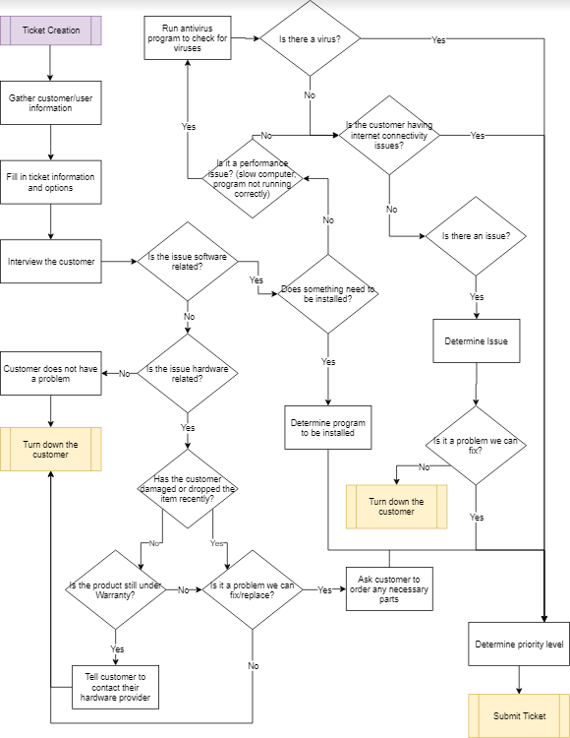
Ticket Creation Information Process Map

Slide 9
Ticket Assignment Policy
As tickets are made, the must be assigned to a technician in order to be resolved and closed. But what technicians will take what tickets? This may also be a matter of which technician is trained in what areas, otherwise known as specialists. One technician may know more about hardware problems than others, hence, they would receive a hardware issue ticket.
As we do not have an automatic ticket assignment process available, the ticket should be submitted without assignment and allow all agents to provide input and decide ticket assignment. It will also allow the technician with better knowledge about a certain topic to claim the ticket rather than have it automatically assigned to another technician that may not know as much.
This method requires all analysts to be alert to when a ticket comes in as to not dissatisfy the customer. Tickets should be monitored by a supervisor to assure they are being claimed by technicians in a timely manner.

Slide 10
Backup Policy
To protect against any event that may cause a loss in data, such as physical disaster or data corruption, the help desk requires a periodical backup of all data. The purpose of this policy is to define the minimum controls required for data backup and to safeguard against the loss of data that may occur due to physical disaster, human error, and software or hardware corruption. This policy applies to all technicians who process or store data within the servers.
There are plenty of different backup options, however, they can only be done at specific times. A Full Backup includes all files of a defined set of data. This copies all files, regardless of whether they have been modified or not. This will set the base for the differential and incremental backups. A full backup will only be done once a week to avoid service interruption, followed by differential and/or incremental backups during the week.
An incremental backup captures only the files changed since the last incremental backup. This means the next time an incremental backup is done, the file is skipped unless it has been modified again. This backup option ensures your backup is up to date and saves both time and storage space.
A differential backup captures only the files that have changed since the last full backup. It will continue to backup files that have changed or added since the last full backup. This requires more storage space, but ensures a smoother, easier, and more reliable restore.

Slide 11
Customer Satisfaction Survery
We want to know what you think! Please provide feedback on your experience and help us improve our service.
On a scale of 1 - 5 (1 = low, 5 = high) please rate the following.
Please use NA for any question that is not applicable.
____The availability of help desk staff/ability to reach them in a timely manner?
____The speed in which your question or incident was resolved?
____The timeliness of updates regarding the status of your issue?
____The quality of service you received?
____The friendliness of the analyst(s) that assisted you?
____The overall service you received?

Slide 12
Customer Satisfaction Survery (Cont’d)
Do you have any extra comments, suggestions, or concerns?
__________________________________________________________________________________________________________________________________________________________________________________________________________________________
If you would like to be contacted again by a manager, please provide an email or phone number. (Optional)
Email ________________________________________________________________________
Phone number ________________________________________________________________

Slide 13
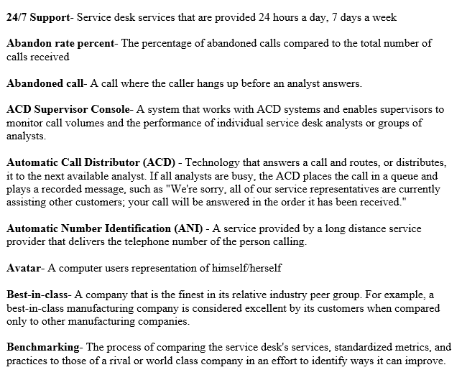
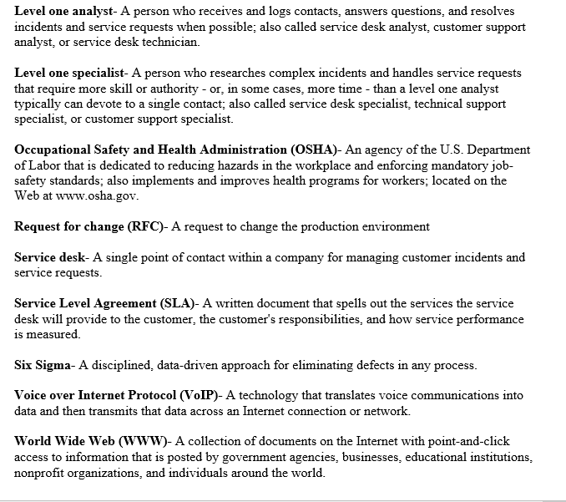
Help Desk Terminology

Slide 14
What We Learned
Always have to keep the customer in mind. Everything we do is to make sure they are satisfied (unless they have some unrealistic standards)
Takes a lot of thought and consideration to run your own service desk

